Slide 1
Lecture 15 Signal Emulation for Astrophysics and Cosmology
Lecturer: Dr Harry Bevins (htjb2)

Slide 2
Overview
Why we need signal emulators?
Example of a 21-cm signal emulator
Example Dimensionality Reduction
Brief discussion of VAEs for SKA tomography and power spectrum
Slides available at https://github.com/htjb/Talks (and Moodle!)
Example codes on github too!

Slide 3
Why we need signal emulators?

Slide 4
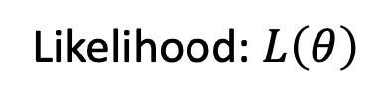
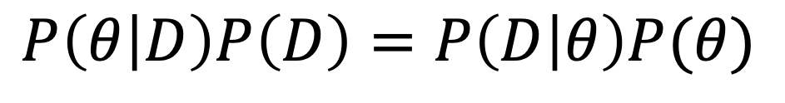
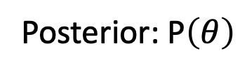
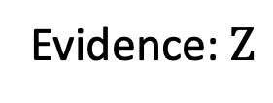
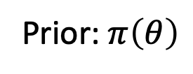
Recap:Bayes theorem
Likelihood: $L\left(θ\right)$
Posterior: P$\left(θ\right)$
Evidence: $Z$
Prior: $π\left(θ\right)$
$$P\left(θ | D\right)P\left(D\right)=P\left(D | θ\right)P(θ)$$
Outputs
Inputs
For Nested Sampling and other MCMC algorithms

Slide 5
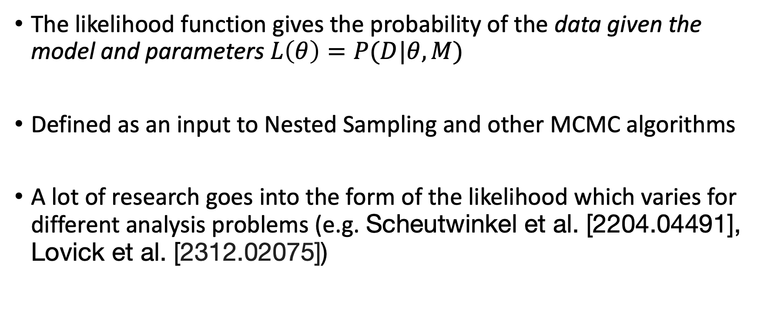
The likelihood function
The likelihood function gives the probability of the data given the model and parameters $L\left(θ\right)=P(D|θ, M)$
Defined as an input to Nested Sampling and other MCMC algorithms
A lot of research goes into the form of the likelihood which varies for different analysis problems (e.g. Scheutwinkel et al. [2204.04491], Lovick et al. [2312.02075])

Slide 6
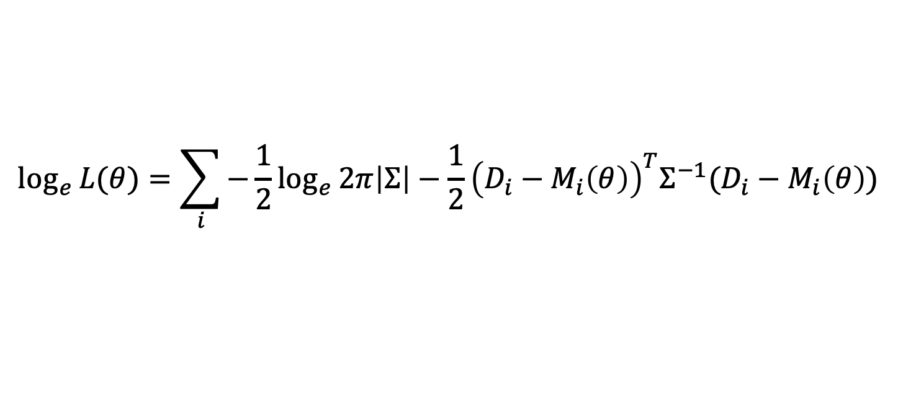
An example likelihood
$$\log_{e}{L(θ)}=\sum_{i}{−\frac{1}{2}\log_{e}{2π\left|Σ\right|−\frac{1}{2}{\left(D_{i}−M_{i}\left(θ\right)\right)}^{T}Σ^{−1}(D_{i}−M_{i}\left(θ\right))}}$$
Work in log space to make things more computationally stable
The functional form of the likelihood defines the noise distribution in your data
Here we are assuming the noise is Gaussian and allowing for a non-diagonal covariance

Slide 7
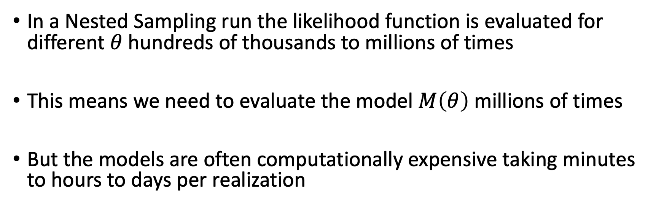
The issue
$$\log_{e}{L(θ)}=\sum_{i}{−\frac{1}{2}\log_{e}{2π\left|Σ\right|−\frac{1}{2}{\left(D_{i}−M_{i}\left(θ\right)\right)}^{T}Σ^{−1}(D_{i}−M_{i}\left(θ\right))}}$$
In a Nested Sampling run the likelihood function is evaluated for different $θ$ hundreds of thousands to millions of times
This means we need to evaluate the model $M\left(θ\right)$ millions of times
But the models are often computationally expensive taking minutes to hours to days per realization

Slide 8
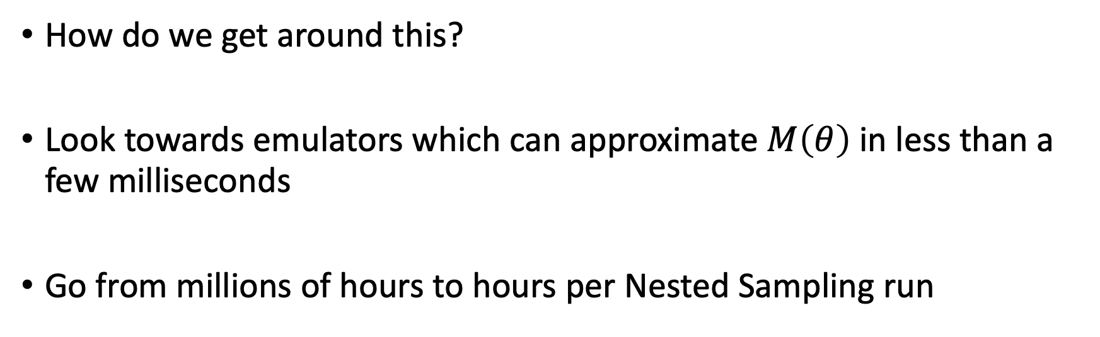
The issue
$$\log_{e}{L(θ)}=\sum_{i}{−\frac{1}{2}\log_{e}{2π\left|Σ\right|−\frac{1}{2}{\left(D_{i}−M_{i}\left(θ\right)\right)}^{T}Σ^{−1}(D_{i}−M_{i}\left(θ\right))}}$$
How do we get around this?
Look towards emulators which can approximate $M\left(θ\right)$ in less than a few milliseconds
Go from millions of hours to hours per Nested Sampling run

Slide 9

What actually is an emulator?
Some approximation of a complex astrophysical model (think N-body, hydrodynamical or semi-numerical simulations)
Often built with machine learning tools
Artificial neural networks and Convolutional neural networks

Slide 10
Sky-averaged 21-cm Cosmology

Slide 11
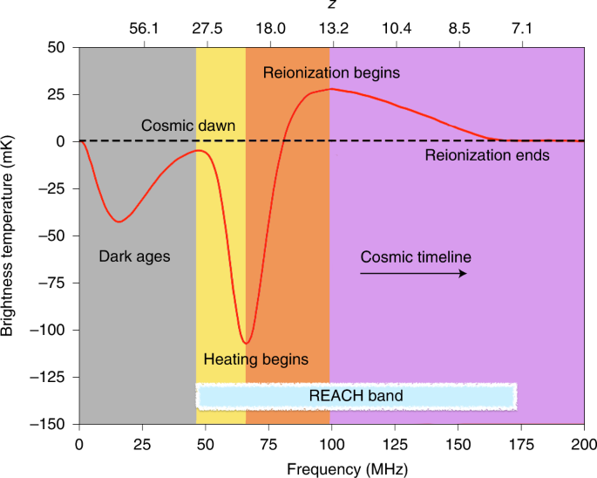
Sky averaged 21-cm Cosmology
Looking for a spectral distortion in the CMB temperature caused by neutral hydrogen
A detection of the signal will help us understand
When the first stars formed ad how bright they were
The nature of dark matter
The abundance and brightness of X-ray emitting objects
When the universe transformed from neutral to ionized

Slide 12
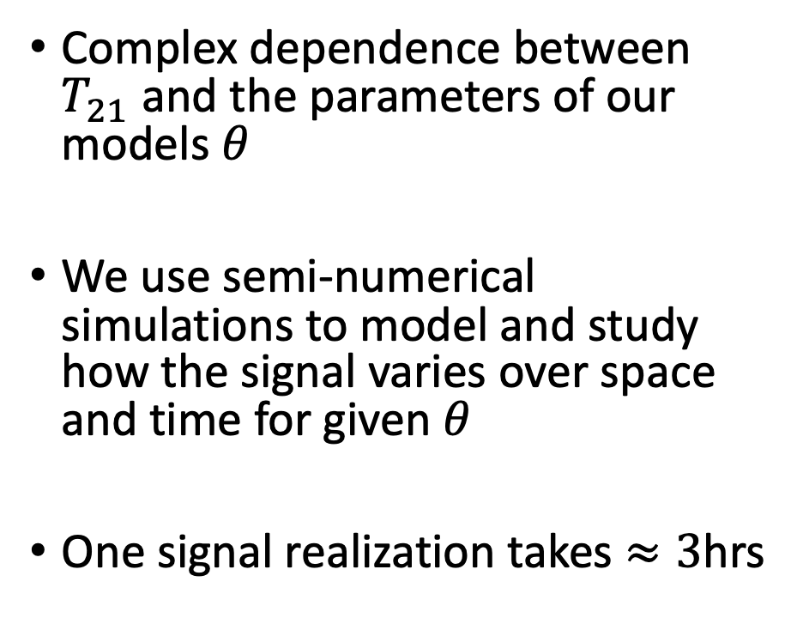
Sky averaged 21-cm Cosmology
Complex dependence between $T_{21}$ and the parameters of our models $θ$
We use semi-numerical simulations to model and study how the signal varies over space and time for given $θ$
One signal realization takes $≈3$hrs

Slide 13
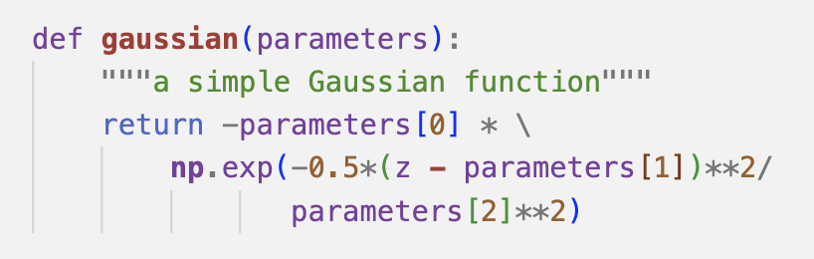
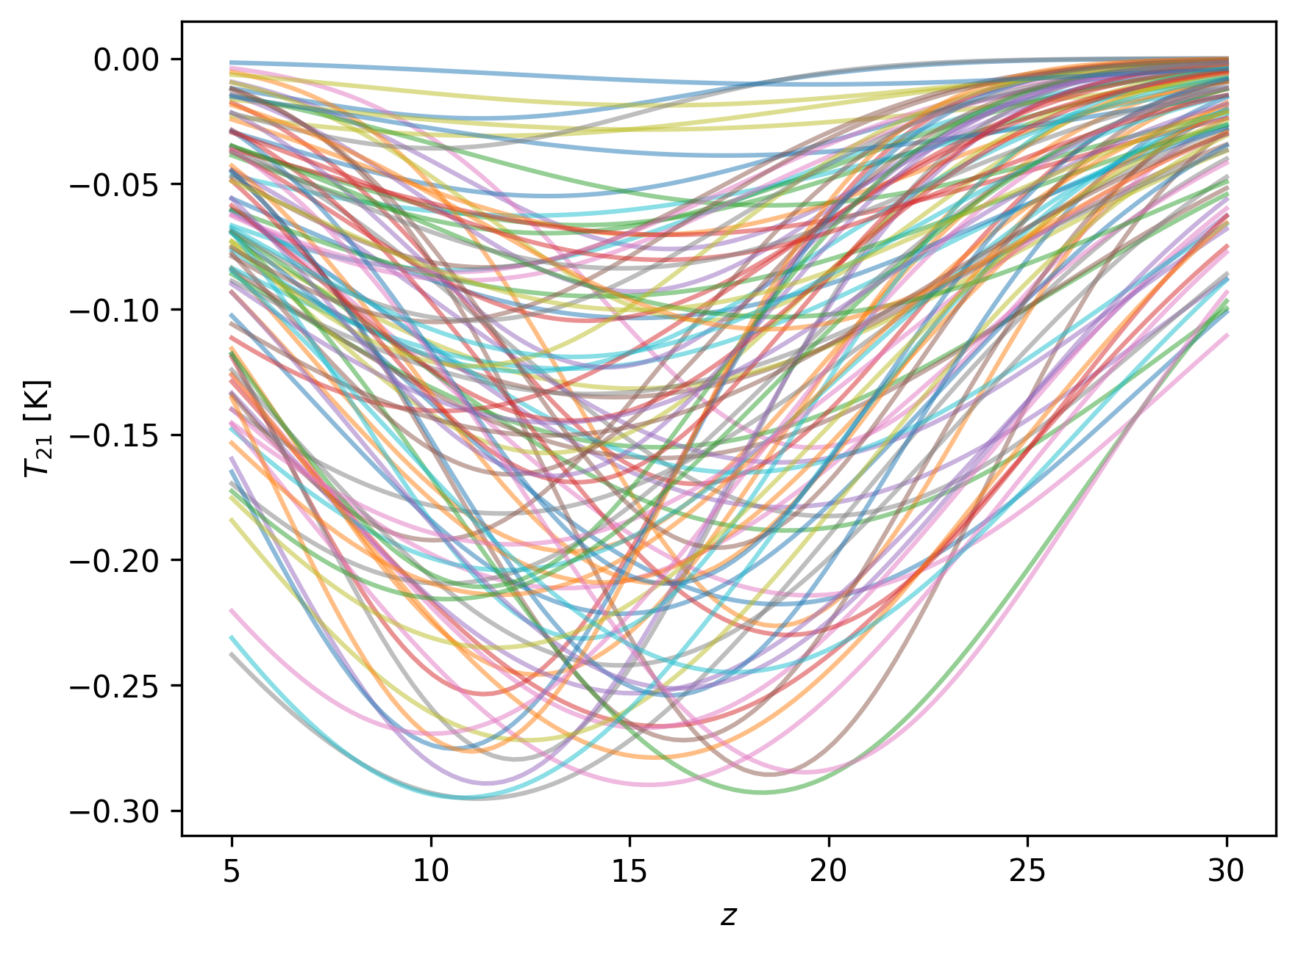
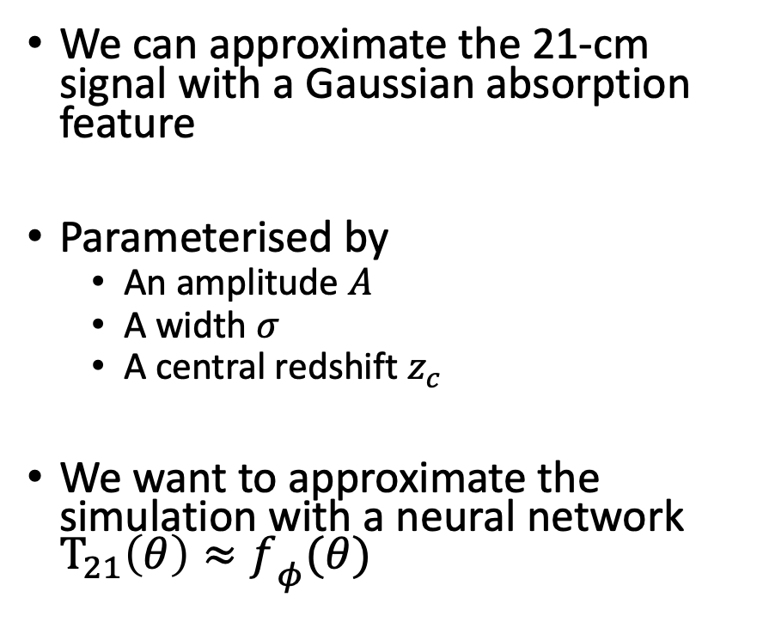
A toy 21-cm Cosmology example
We can approximate the 21-cm signal with a Gaussian absorption feature
Parameterised by
An amplitude $A$
A width $σ$
A central redshift $z_{c}$
We want to approximate the simulation with a neural network $T_{21}\left(θ\right)≈{f_{ }}_{φ}(θ)$

Slide 14
Designing the emulator
Need to consider
Loss function and early stopping
Architecture and dimensionality reduction
Normalization
Activation functions
Measures of accuracy

Slide 15
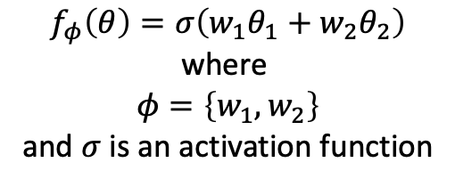
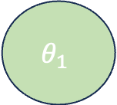
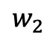
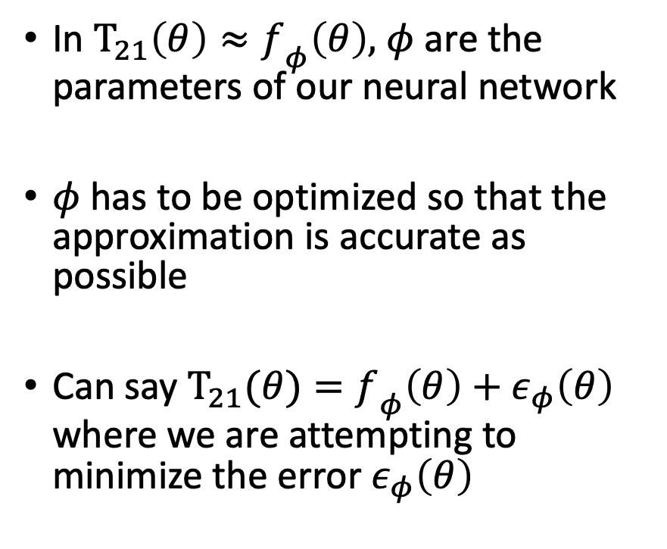
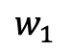
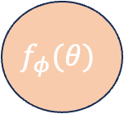
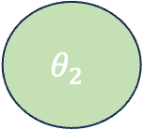
Emulators as an approximation
$$θ_{1}$$
In $T_{21}\left(θ\right)≈{f_{ }}_{φ}\left(θ\right),$ $φ$ are the parameters of our neural network
$φ$ has to be optimized so that the approximation is accurate as possible
Can say $T_{21}(θ)={f_{ }}_{φ}\left(θ\right)+ε_{φ}\left(θ\right)$ where we are attempting to minimize the error $ε_{φ}\left(θ\right)$
$$w_{1}$$
$$f_{φ}(θ)$$
$$θ_{2}$$
$$w_{2}$$
$$f_{φ}\left(θ\right)=σ\left(w_{1}θ_{1}+w_{2}θ_{2}\right)$$
where
$$φ=\left\{w_{1},w_{2}\right\}$$
and $σ$ is an activation function

Slide 16
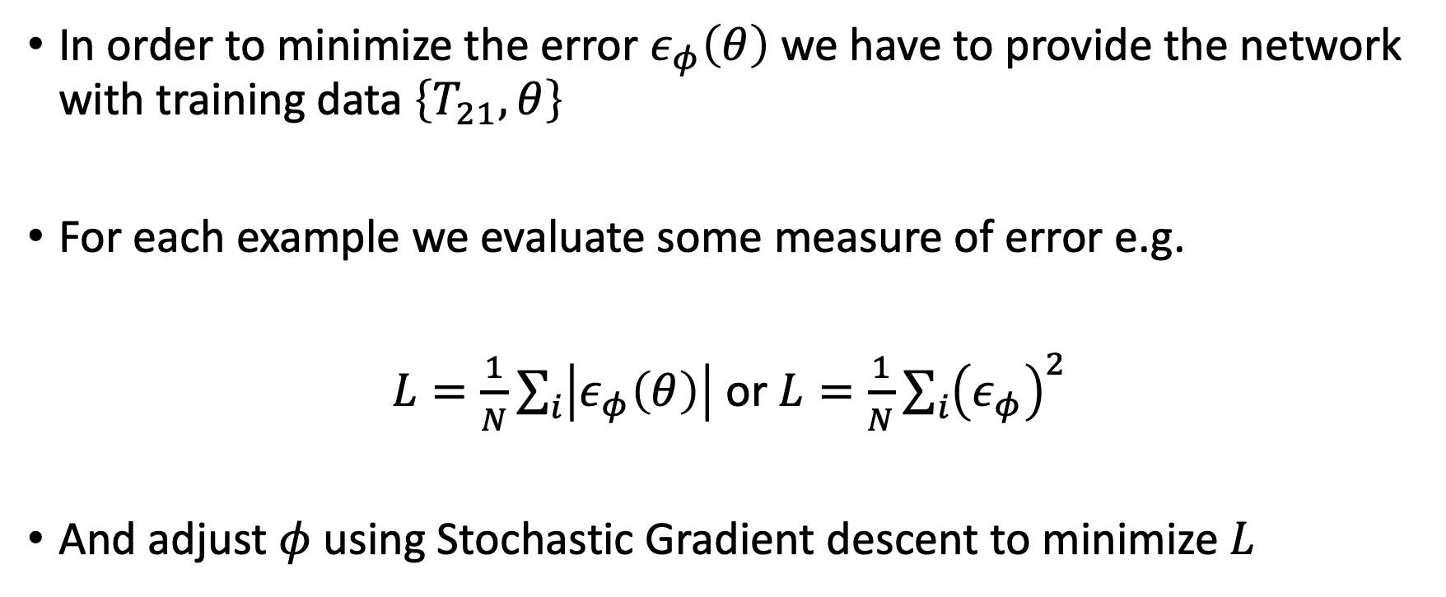
Loss Function
In order to minimize the error $ε_{φ}\left(θ\right)$ we have to provide the network with training data $\left\{T_{21}, θ\right\}$
For each example we evaluate some measure of error e.g.
$L=\frac{1}{N}\sum_{i}{\left|ε_{φ}\left(θ\right)\right|}$ or $L=\frac{1}{N}\sum_{i}{{\left(ε_{φ}\right)}^{2}}$
And adjust $φ$ using Stochastic Gradient descent to minimize $L$

Slide 17
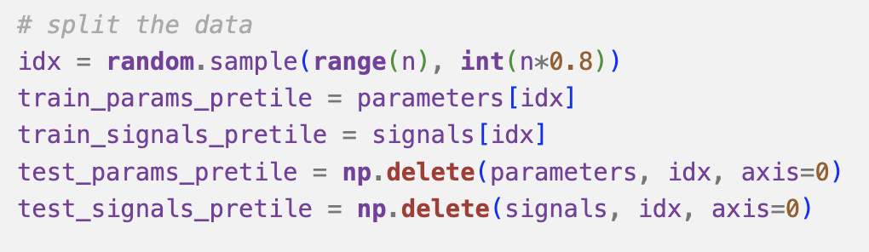
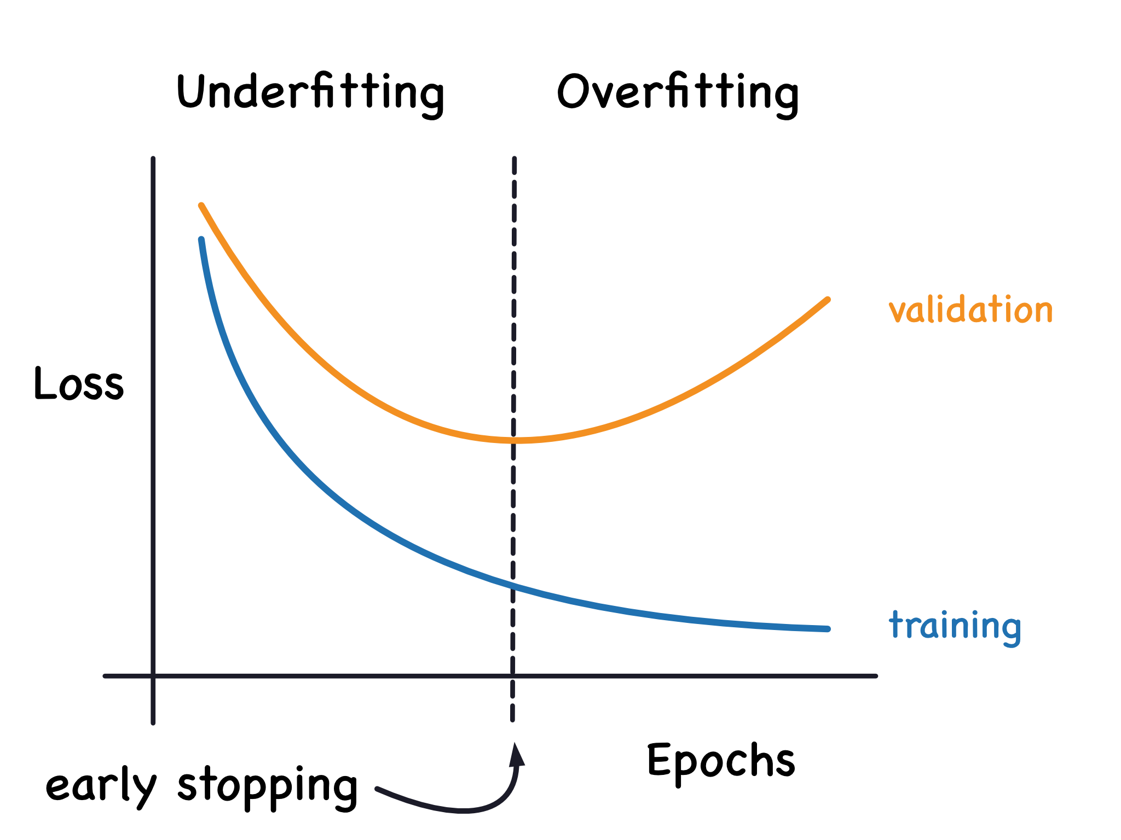
Training and test data
We typically generate a few thousand simulations for training
We reserve a proportion for testing emulator accuracy during training (early stopping)
Prevents overfitting of the training data

Slide 18
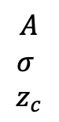
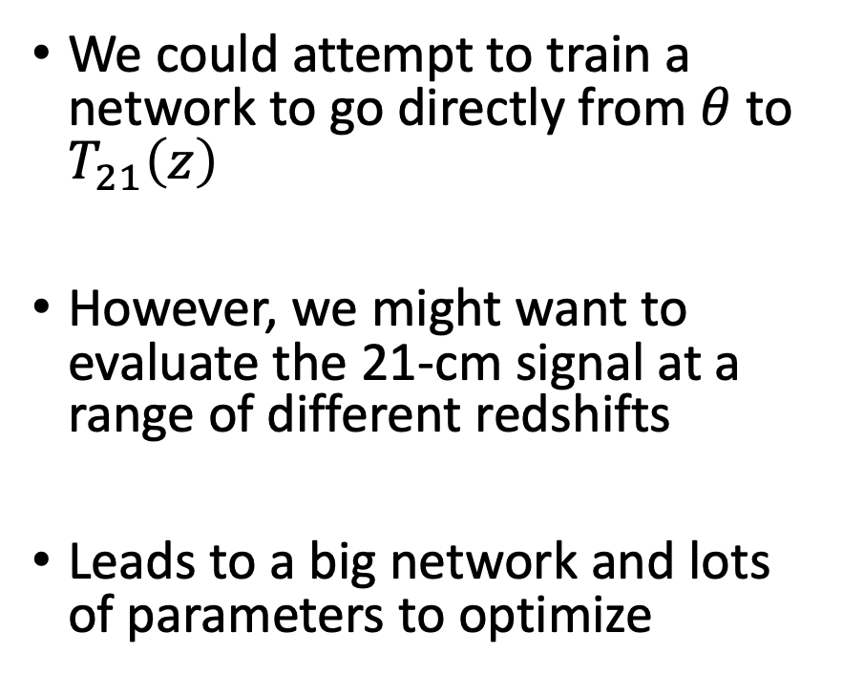
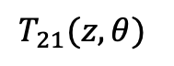
Architecture choices
We could attempt to train a network to go directly from $θ$ to $T_{21}\left(z\right)$
However, we might want to evaluate the 21-cm signal at a range of different redshifts
Leads to a big network and lots of parameters to optimize
$$A$$
$$σ$$
$$z_{c}$$
$$T_{21}(z, θ)$$

Slide 19
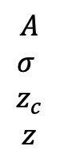
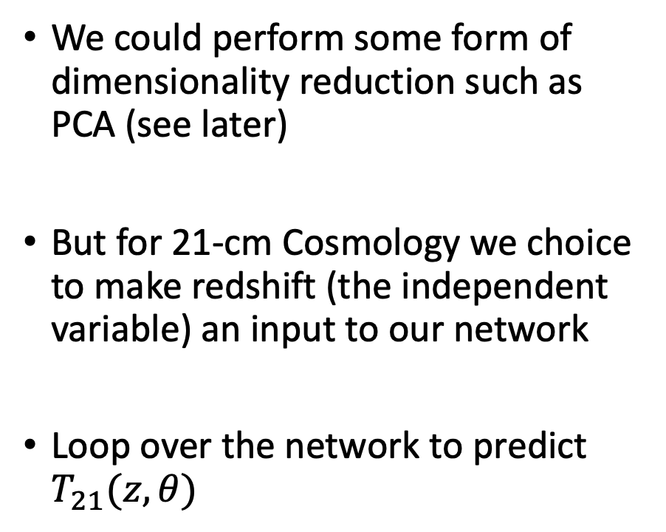
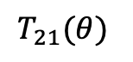
Architecture choices
We could perform some form of dimensionality reduction such as PCA (see later)
But for 21-cm Cosmology we choice to make redshift (the independent variable) an input to our network
Loop over the network to predict $T_{21}(z, θ)$
$$A$$
$$σ$$
$$z_{c}$$
$$z$$
$$T_{21}(θ)$$

Slide 20
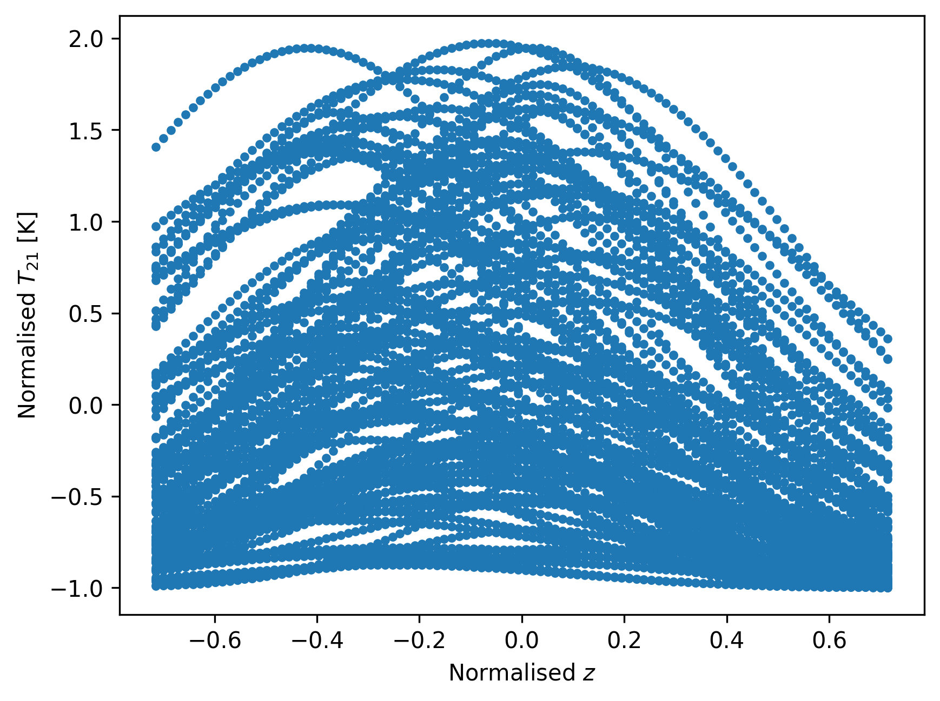
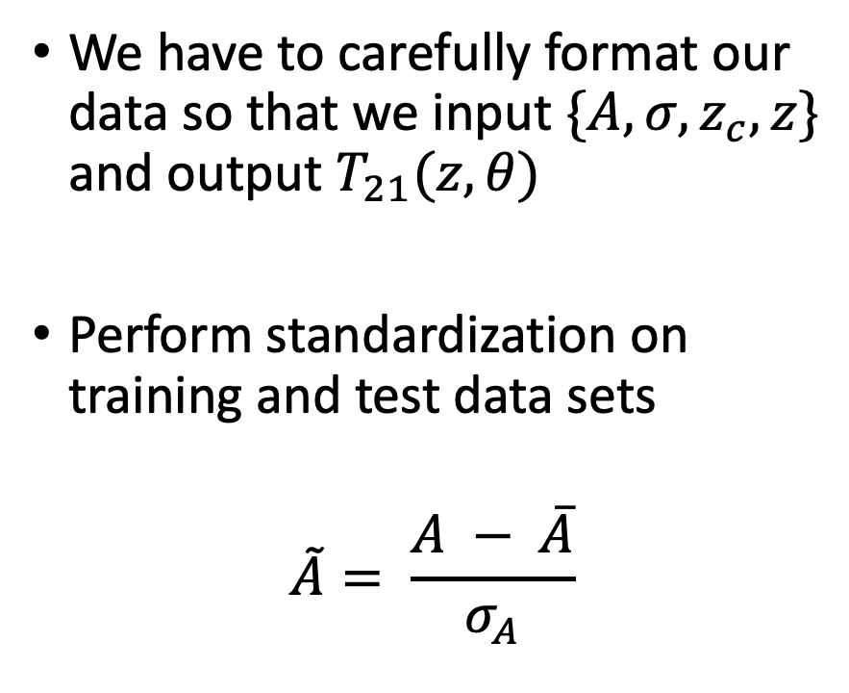
Normalisation and data processing
We have to carefully format our data so that we input $\{A, σ, z_{c}, z\}$ and output $T_{21}(z, θ)$
Perform standardization on training and test data sets
$$\tilde{A}= \frac{A − \overline{A}}{σ_{A}}$$

Slide 21
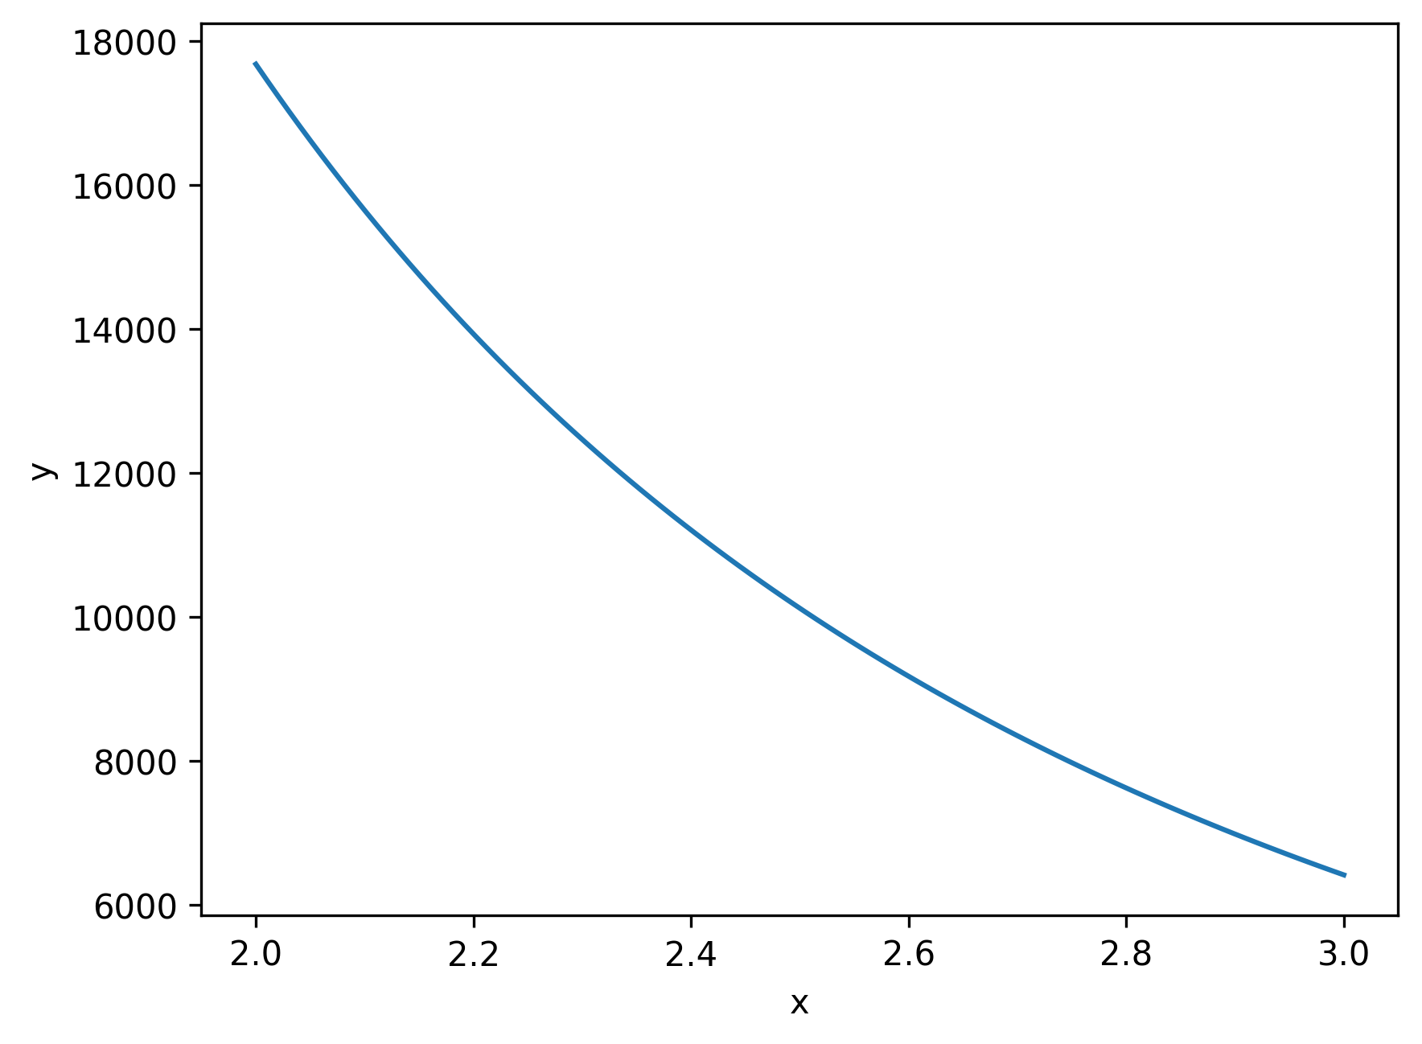
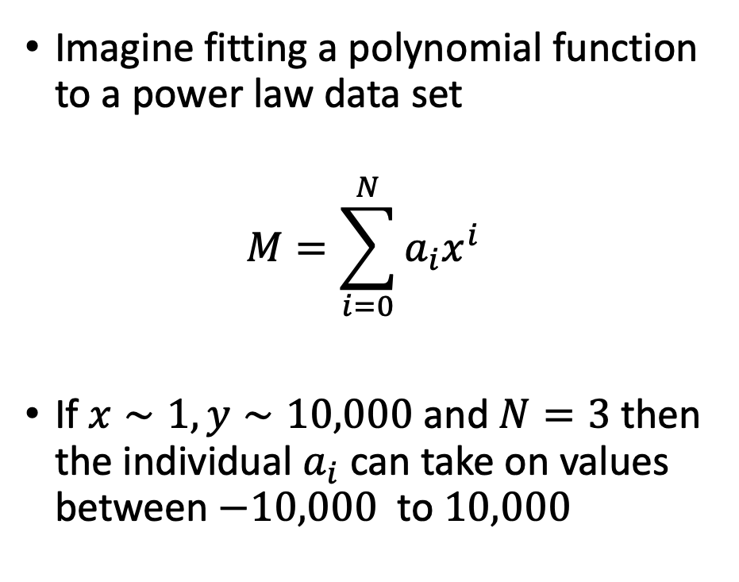
Why do we normalize?
Imagine fitting a polynomial function to a power law data set
$$M=\sum_{i=0}^{N}{a_{i}x^{i}}$$
If $x∼1, y∼10,000$ and $N=3$ then the individual $a_{i}$ can take on values between $−10,000$ to $10,000$

Slide 22
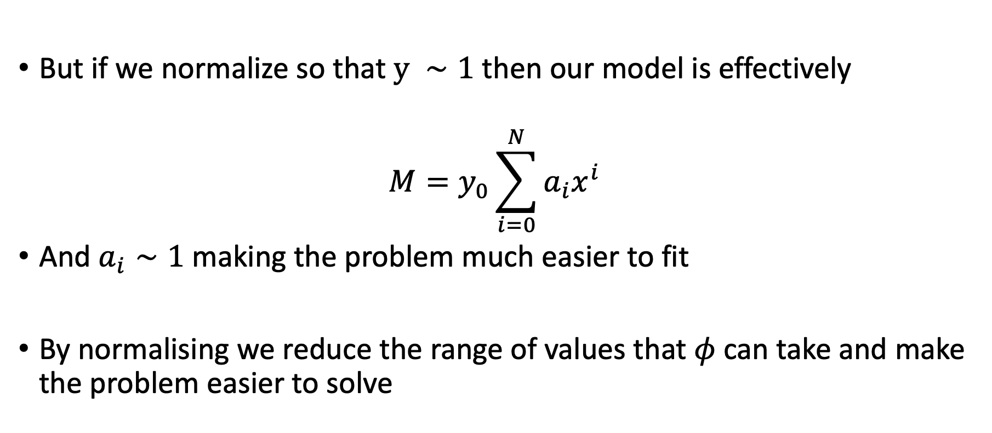
Why do we normalize?
But if we normalize so that $y ∼1$ then our model is effectively
$$M=y_{0}\sum_{i=0}^{N}{a_{i}x^{i}}$$
And $a_{i}∼1$ making the problem much easier to fit
By normalising we reduce the range of values that $φ$ can take and make the problem easier to solve

Slide 23
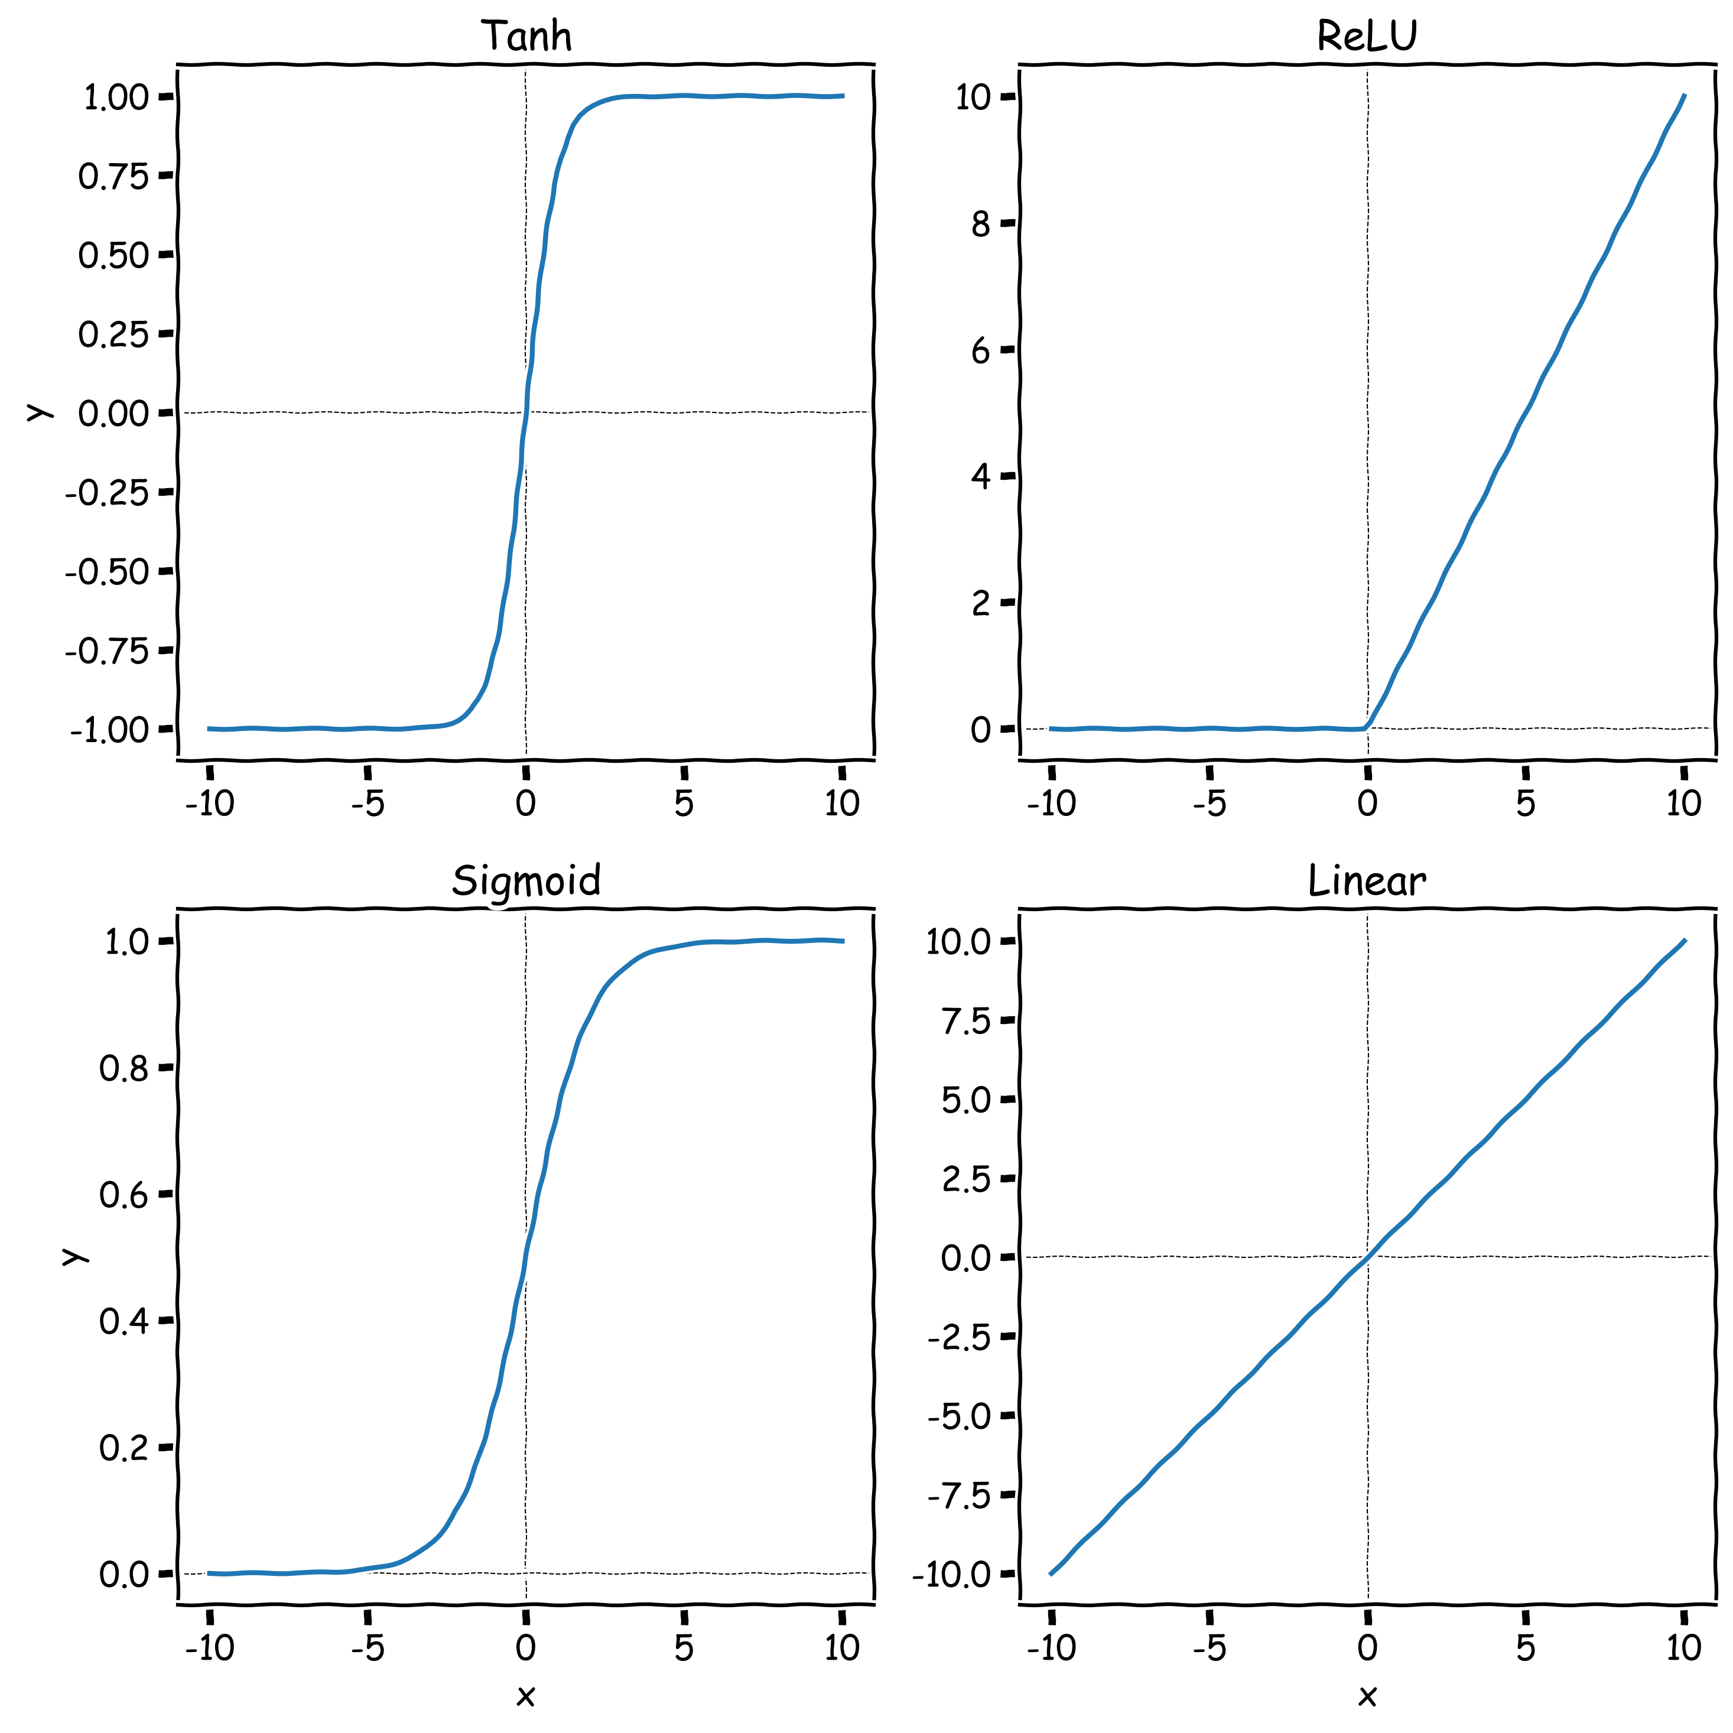
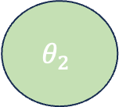
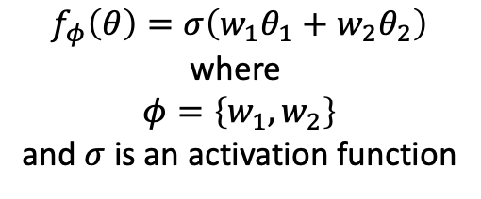
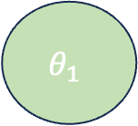
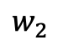
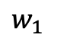
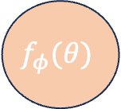
Activation Functions
$$θ_{1}$$
$$w_{1}$$
$$f_{φ}\left(θ\right)=σ\left(w_{1}θ_{1}+w_{2}θ_{2}\right)$$
where
$$φ=\left\{w_{1},w_{2}\right\}$$
and $σ$ is an activation function
Activation functions add non-linearity into our modelling
We often want to make careful choices for our activation functions
E.g. if we know our output (after normalization) should be between 0-1 we might choose a sigmoid activation
$$f_{φ}(θ)$$
$$θ_{2}$$
$$w_{2}$$

Slide 24
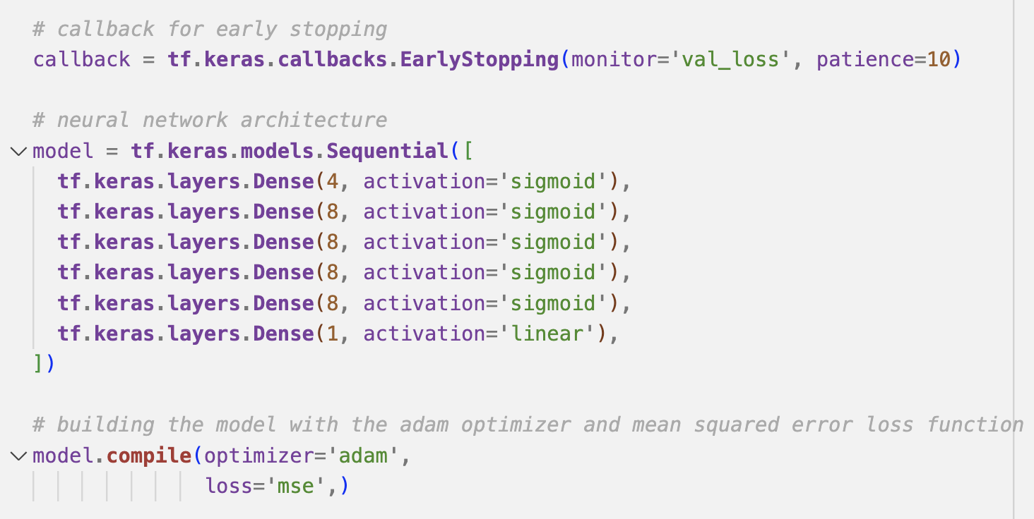
Building the neural network

Slide 25
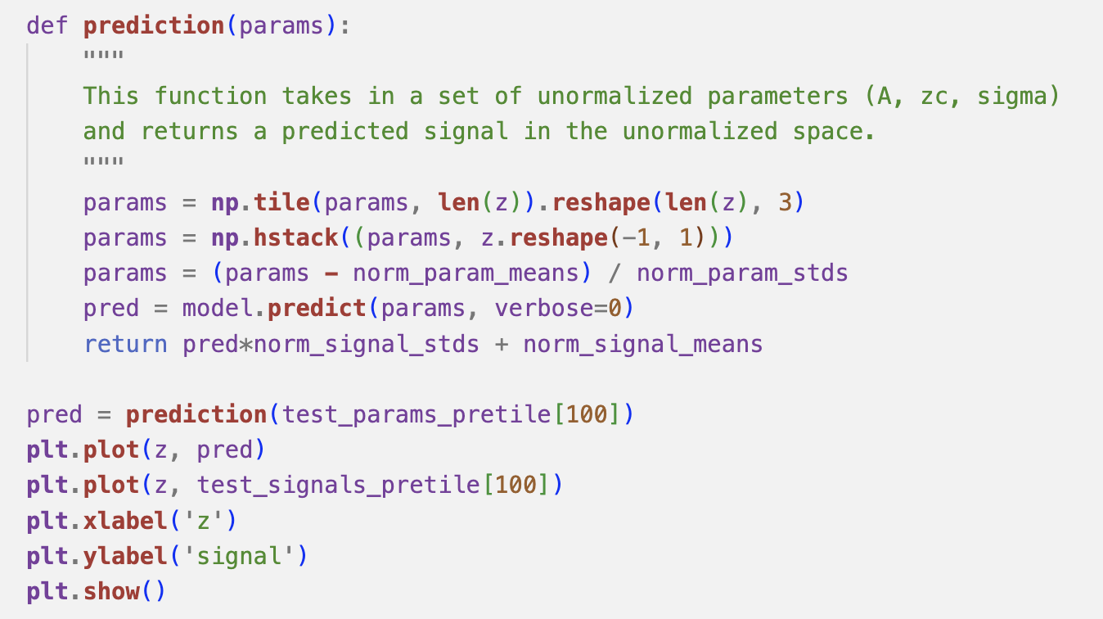
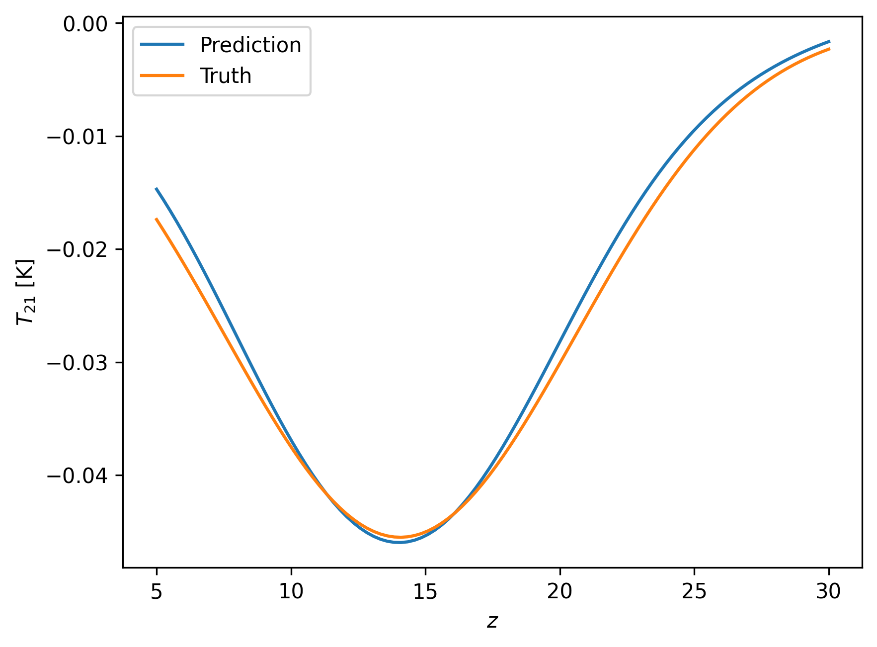
Assessing the accuracy
Once trained we want to assess whether the network is doing a good job before we use it in our Bayesian analysis
The network will predict signals in the normalized space

Slide 26
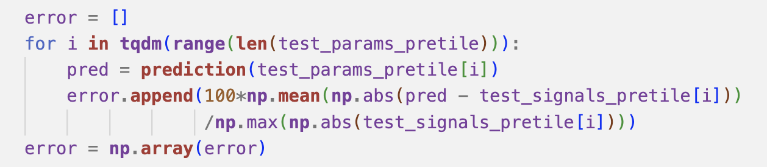
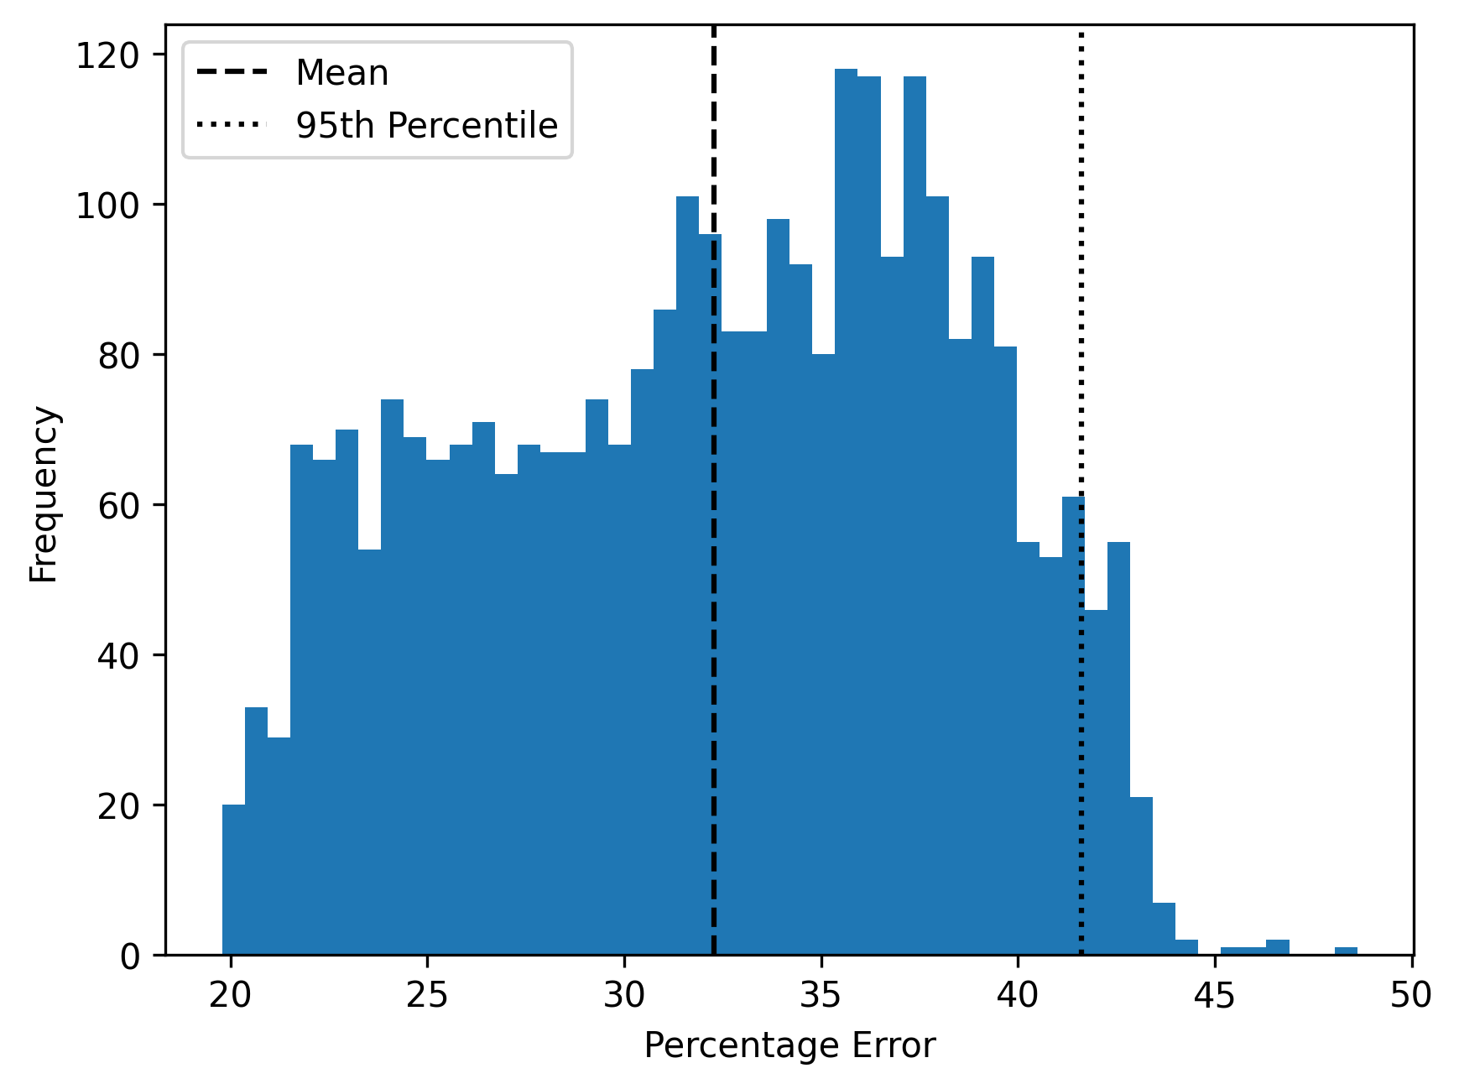
Assessing the accuracy
Often we want a more general measure of accuracy
We assess on the whole test data set and take the average and 95th percentile values
This network isn’t very accurate!

Slide 27
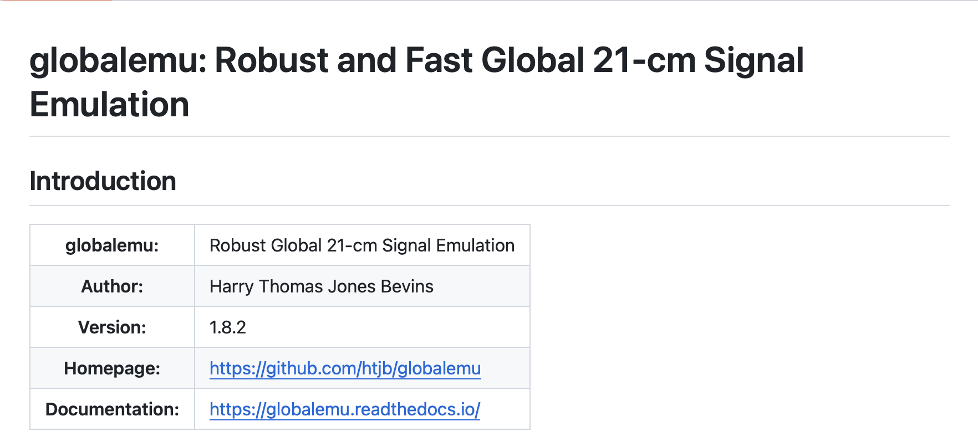
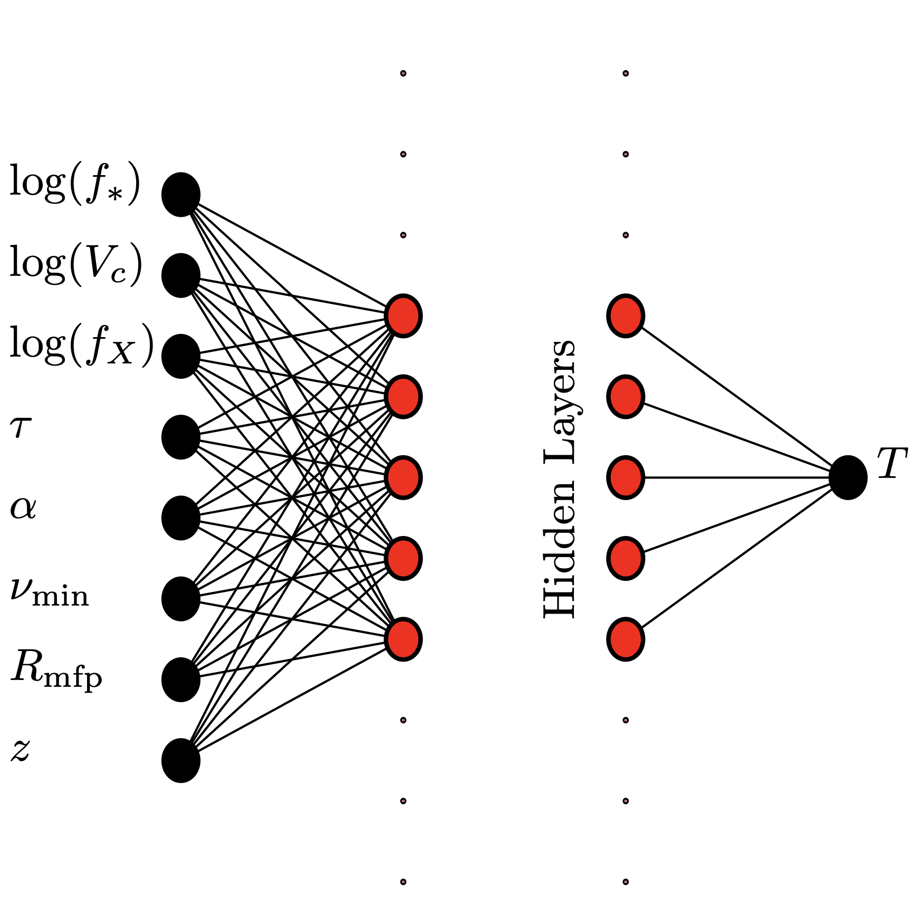
Current state of the art
There are many approaches for emulating the sky-averaged 21-cm signal
globalemu [2104.04336] uses some of the ideas discussed here
It is light weight, easy to retrain and very fast while maintaining a good level of accuracy

Slide 28
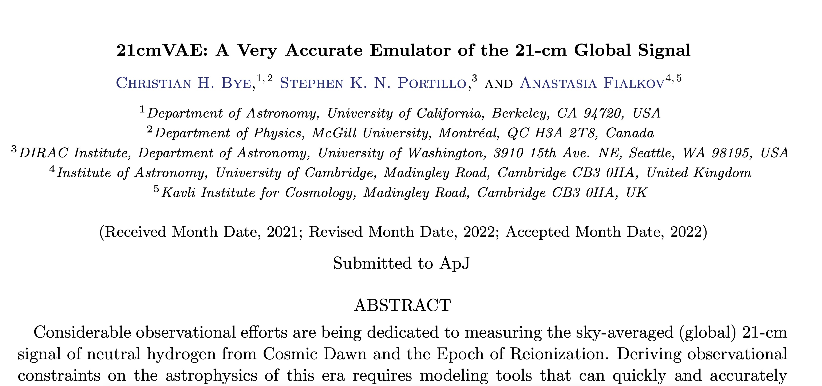

Current state of the art
21cmVAE [2107.05581] uses Variational Autoencoders
More complicated architecture, harder to retrain and an order of magnitude slower than globalemu
But more accurate than globalemu

Slide 29
Current state of the art
21cmLSTM

Slide 30
Dimensionality Reduction

Slide 31
Dimensionality Reduction
The idea is to compress the data so that we can predict a few parameters
And then reconstruct the signal from those parameters
The issue is that these techniques are often result in information loss

Slide 32

Principle Component Analysis
Decompose training data into eigenvectors and order based on eigenvalues
Eigenvectors with largest eigenvalues describe the directions in the training data with the biggest variance
Discard eigenvectors that correspond to low variance directions
Reconstruct signals with weighted sum of most important eigenvectors where weights vary for each signal

Slide 33



Principle Component Analysis
$$A$$
$$σ$$
$$z_{c}$$
Signal Specific PCA coefficients
Important eigenvectors
Sum
terms
$${= T}_{21}(z, θ)$$
$$×$$

Slide 34


Cosmopower
Emulating the CMB power spectrum [2106.03846] as a function of cosmological parameters
Very accurate and easily retrainable
Uses Principle Component Analysis

Slide 35
21-cm Power Spectrum with the SKA

Slide 36



The SKA and 21-cm Cosmology
Bera et al. 2022 [2210.12164]
$$z≈9$$
The SKA will attempt to measure how the 21-cm signal varies spatially and temporally on the sky
This is known as tomography
Can extract science from tomography and summary statistics like the power spectrum

Slide 37

Random Fields and the 21cm signal
The 21cm signal during the cosmic dawn follows the distribution of galaxies
Distribution of galaxies is set by the initial density fluctuations in the early universe
This is a gaussian random field with some correlated structure

Slide 38

Random Fields and the 21cm signal
The trick here is that you can have many different fields with the same properties
They share a power spectrum that encodes the correlations
That power spectrum and therefore field for 21-cm is dependent on astrophysics

Slide 39

How do we handle images?
Typically use Convolutional Neural Networks
Traditionally used for pattern recognition
And subsequent classification of images
Can also use normalising flows (next lecture) and diffusion models
Credit

Slide 40

Convolutional Layers
Convolutional layers take an image and slide a filter across the image performing a dot product as they go
Many filters are used to pick out key features gives you a stack of filtered images or a volume
Filters can be 2D or 3D in nature to increase or decrease the volume of the feature space at each layer

Slide 41


De-convolutional Layers
The idea here is to up sample an image
This is done by padding the image with zeros
Then running a convolution over it with a kernel that returns the same shape as the padded image

Slide 42

Variational Autoencoders
We want a way to emulate the tomographic images with certain characteristics that captures the stochastic nature of the fields
We can do this with variational autoencoders
They are composed of two components and encoder and a decoder

Slide 43

The latent space
The goal of the encoder is to compress the image into a latent space that closely resembles a known analytic distribution
Typically use a standard normal distribution
Learn a mean and variance conditioned on the parameters of the power spectrum

Slide 44



The encoder
Flatten
image
More specific
features
Convolve with filters
to extract features
Image
Dense Layers
$μ(x, θ)$
$$z\left(x, θ\right) \sim N(0, 1)$$
$$σ\left(x, θ\right)$$
Power Spectrum
Parameters

Slide 45

The decoder
More specific
features
Convolve with filters
to extract features
Dense Layers
Reshaping
$$N(0, 1)$$
Power Spectrum
Parameters

Slide 46


Toy example
We can generate gaussian random fields with a given power spectrum equal to
$$P\left(k\right)=k^{−β}$$
where $β$ is a free parameter in the model

Slide 47

Training
The goal is to train the encoder-decoder pair so that
the latent space looks a lot like the standard normal
And the images are reconstructed well
$$L= \frac{1}{N}\sum_{i}{{\left(x −x_{Pred}\right)}^{2}+KL(z^{′}||z) }$$

Slide 48

Example of training output

Slide 49

Example of training output

Slide 50

Generating new samples
Once trained we can draw samples from the normal distribution
Put them into the decoder with a value for the slope of the power spectrum and generate new realisaitons of the density field

Slide 51

For the SKA 21-cm Observations
The likelihood is going to be on the power spectrum
In practice we would likely just emulate the power spectrum directly
But it’s a nice example of how to work with images
An example application using CNNs to directly emulate the 2D power spectrum can be found in 21cmEMU [2309.05697]

Slide 52
Summary

Slide 53
Emulators allow us to do inference
Emulators are an efficient way to approximate complex semi-numerical simulations
They take of order milliseconds to evaluate compared to hours per realization making inference possible
Sensible choices about architectures, use of dimensionality reduction techniques, activation functions, loss funcitons etc can make a big difference to the run time and accuracy of emualtors

Slide 54
Many different ways to do this
Host of different tools that can be used to build emulators
Here we have looked at Dense Neural Networks and Convolutional Neural Networks
But we can also do this with Normalizing Flows and Gaussian Processes for example
Slides available at https://github.com/htjb/Talks (and Moodle!)
Example codes on github too!

Slide 55
Next Lecture: Simulation Based Inference
Why not just emulate the whole likelihood?

